Slide 1
Swachhata Pakhwada
Swachhata Hi Seva – Secy 2023
Review by Cabinet Secretary
16th September 2023

Slide 2
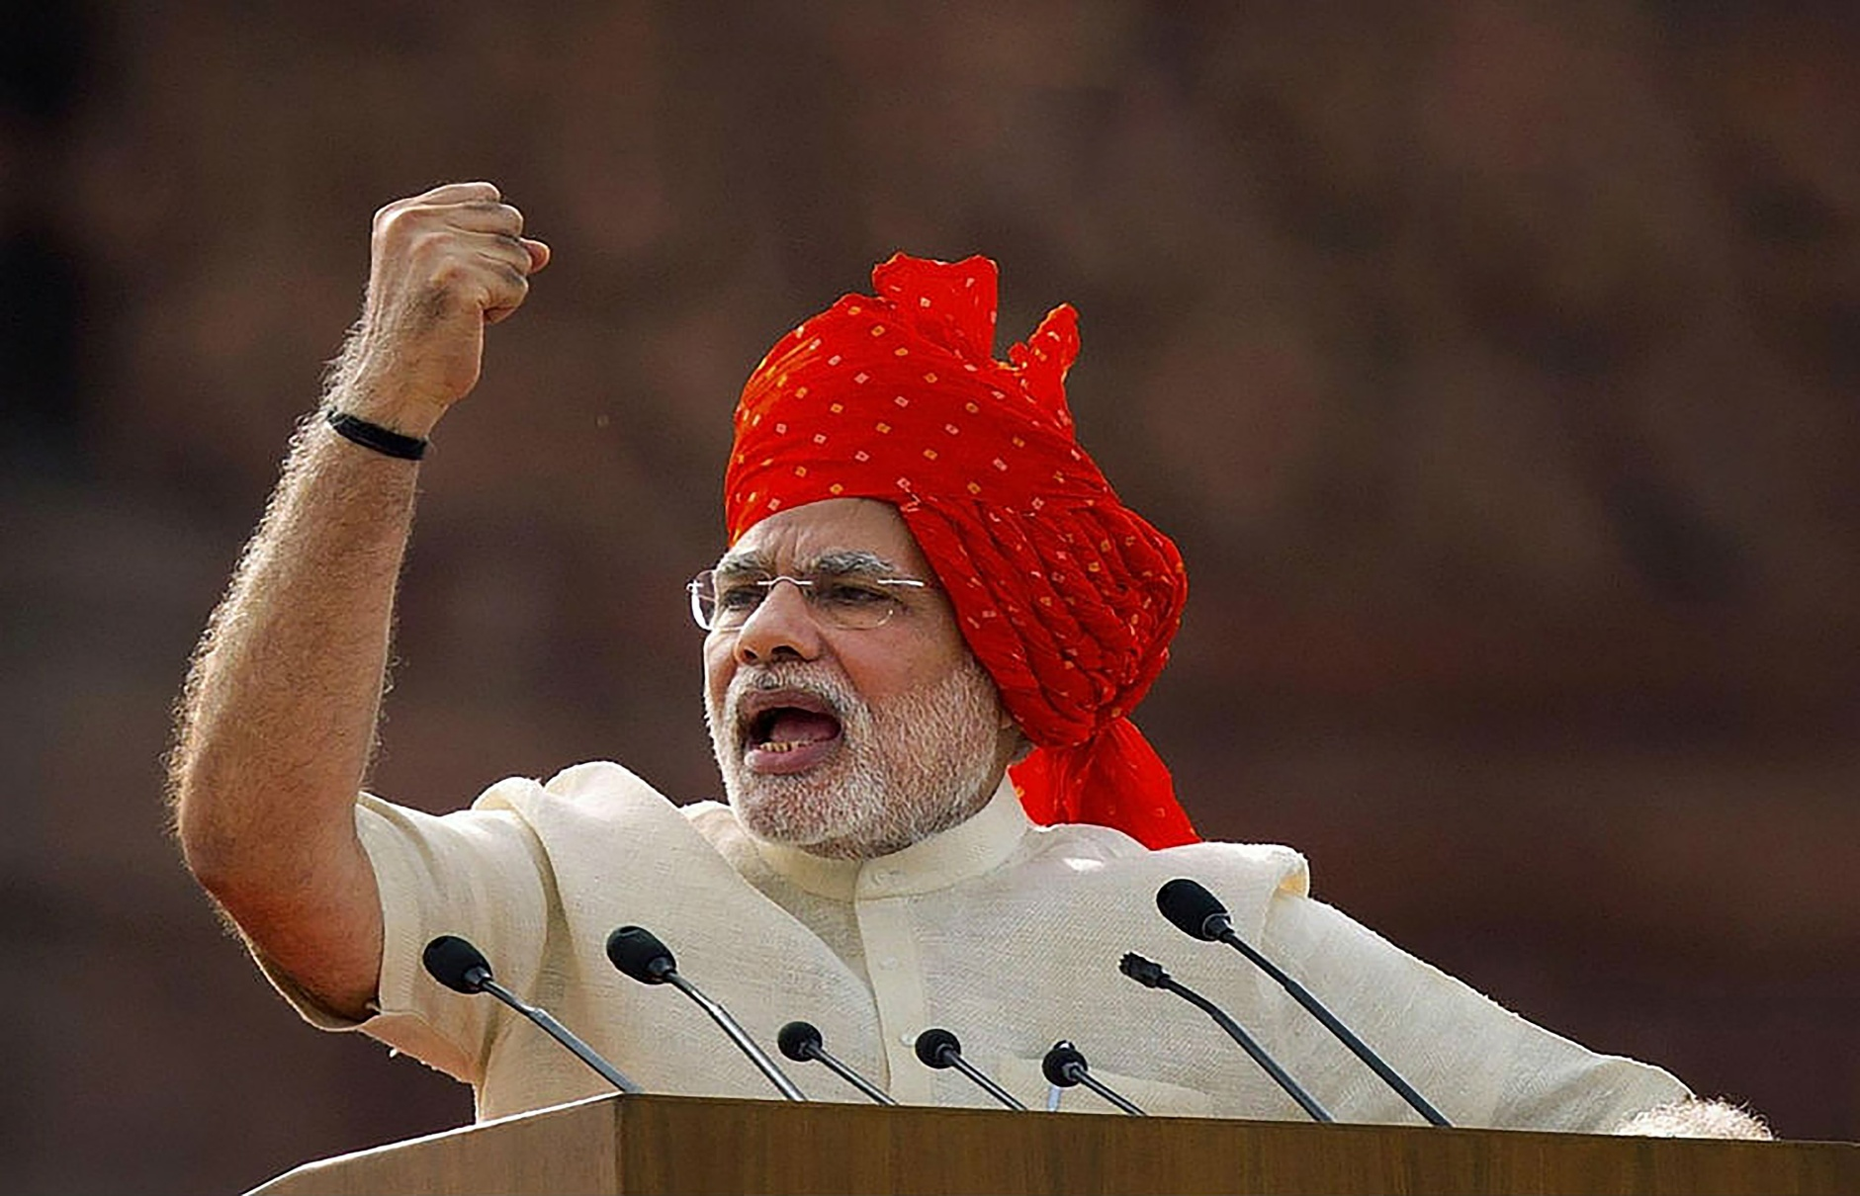
The Clarion Call in 2014
A clean India is the best tribute we can pay to Bapu when we celebrate his 150th birth anniversary in 2019… The time has come to devote ourselves towards ‘Swachhata' of our motherland.
Prime Minister Narendra Modi, New Delhi, 2014.
2

Slide 3
Key Achievements
IHHL
Jan Andolan for Swachhata at scale
Increased attendance of schoolgirls
Enhanced dignity of women
Reduction in waterborne diseases
Empowerment of SHGs
12 Cr. IHHL units
CT/PT
3.11 Lakh CT/PT complexes
India declared ODF
3
Notes:
3

Slide 4
Visibly Cleaner Nation
Garbage transport facilities created
Culture of Door-to-Door garbage collection
Focus on high footfall places
Whole of Government approach
4
Notes:
4

Slide 5
Swachh Survekshan(Urban) 2022
Waste Processing | States/UTs
>80% | 1 UT Chandigarh
60%-80% | 2 UTs and 5 States A&N Islands, Dadra & Nagar Haveli and Daman & Diu, Gujarat, Chhattisgarh, Telangana, Maharashtra, Madhya Pradesh
30%-60% | 6 States Himachal Pradesh, Andhra Pradesh, Uttar Pradesh, Jharkhand, Odisha, Haryana
0-30% | 4 UTs and 16 States J&K, Puducherry, Delhi, Ladakh, Assam, Arunachal Pradesh, Tripura, Sikkim, Manipur, Nagaland, Meghalaya, Mizoram, Karnataka, Uttarakhand, Punjab, Goa, Rajasthan, Tamil Nadu, Bihar, Kerala
* Except West Bengal
5
Notes:
5

Slide 6
Performance of Top 100 Cities
6
Notes:
6

Slide 7
Priority Areas for Garbage Free India
1
Source segregation of waste
2
100% Door to Door collection and timely transportation
3
100% processing of Solid Waste:
MRF centers for recyclables and non-recyclables
Wet Waste to Compost
GOBARdhan – Biogas/CBG/CNG plants
Emphasis on Million+ Cities
Waste to Electricity plants for Mega Cities
7
Waste to Wealth for Circular Economy
Integration of informal sector
Involvement of SHGs
Implementation of EPR
4

Slide 8
Priority Areas for Garbage Free India
5
Remediation of all existing dumpsites
6
Aspirational Toilets & CT/PTs
Ensuring functionality
O&M
7
Used Water Management - decentralized approach for Gram Panchayats and smaller cities
9
Manhole to Machinehole (Occupational Safety for SafaiMitras)
8
10
‘Jan Andolan' the soul of the approach

Slide 9
Rural Urban Convergence
Land Management
Cluster approach for setting up of solid and liquid waste processing plants
Clusters for Scientific Sanitary Landfills
Feedstock convergence for GOBARdhan plants
State and National highways adjacent areas cleaning at regular intervals
Convergence of funds under SBM- Rural and Urban
Mechanical desludging facilities for septic tanks in Rural and Urban areas
9
Notes:
9

Slide 10
Swachh Bharat Mission (Grameen)
An ODF Plus village is defined as “a village which
sustains its Open Defecation Free (ODF) status,
& has arrangements for solid and liquid waste management
and is visually clean”
10

Slide 11
ODF Plus Stages
ODF Plus – उदीयमान/ Aspiring
ODF Plus – उज्ज्वल/ Rising
ODF Plus – उत्कृष्ट/ Model
A village that:
Sustains ODF status
Has arrangements either for SWM or LWM
A village that:
Sustains ODF status
Has arrangements for both SWM and LWM
A village that:
Sustains ODF status
Has arrangements for both SWM and LWM
Observes visual cleanliness i.e., minimal litter, minimal stagnant wastewater and no plastic waste dump in public places
Displays ODF Plus IEC messages
11

Slide 12
Over 4.4 lakh villages achieved ODF Plus (any category)
As on 1st April 2022
As on 15th Sep 2023
6.7 % ODF Plus villages
75 % ODF Plus villages
14 States/UTs, 311 Districts and 4,033 Blocks have 100% ODF Plus villages

Slide 13
Status of ODF Plus villages
13

Slide 14
Over 94,000 ODF Plus Model villages
As on 1st April 2022
As on 15th Sep 2023
2.4 %
ODF Plus (Model) villages
16%
ODF Plus (Model) villages
A & N Islands, D & N Haveli and Daman & Diu, Jammu & Kashmir and Sikkim have 100% ODF Plus Model villages
76 Districts and 944 Blocks have 100% ODF Plus (Model) villages
14

Slide 15
Waste management in rural areas
Preferred option – Household level treatment
Faecal Sludge
Twin Pit Toilets
Grey Water
HH Soak pits/kitchen gardens
Organic Waste
HH Compost Pits/Feeding to Cattle

Slide 16
Waste management in rural areas
If household treatment not feasible, community solutions to be adopted
Faecal Sludge
Mechanical desludging
Treatment at STP/FSTP
Community soak pits/
Waste stabilization ponds, Constructed wetlands etc
Grey Water
Organic Waste
Community compost pits/ GOBARDhan plants
Plastic Waste to be dealt at community level only
Collection and transportation
Segregation Sheds
Plastic Waste Management Unit (PWMU) at Block level
3.14 lakh
Vehicles for collection & transportation of waste
1.76 lakh
Segregation sheds
2,369 Plastic Waste Management Units at Block level

Slide 17
17

Slide 18
Background
Celebrate 9 years of Swachh Bharat Mission
‘Whole of Government’ approach
Visibly higher order of cleanliness through shramdaan & jan bhagidari
All Ministries, States/UTs, ULBs & GPs
Theme: Garbage Free India
15th Sept - 2nd Oct 2023
Timelines
S.No | Activities | Date
1 | Launch of Swachhata Pakhwada 2023 | 15th Sept
2 | On ground activities | 15th - 30th Sept
3 | Swachhata Diwas Celebration | 1st - 2nd Oct
18

Slide 19
Action Points for States/UTs
Coordination meeting by Chief Secretary
Ceremonial launch of SHS- 2023
On ground activities:
Indian Swachhata League - (17th Sept )
SafaiMitra Suraksha Shivir (18th – 25th Sept)
Swachhata Hi Seva Cleanliness Drives (15th – 30th Sept)
Activities to peak on ‘Swachhata Diwas - 1st & 2nd Oct
19

Slide 20
Proposed SHS Activities
Objective - Reinvigorating community participation i.e. jan andolan towards Swachh Bharat Mission
Cleanliness drives resulting in a visibly cleaner nation
Gamify cleaning - daily reporting and monitoring
Repair and refurbishment of all SBM assets like litter bins, public toilets, dhalaos, waste transport vehicles, MRFs etc
Public involvement in Journey of Waste
Engagement with students including visits to waste processing plants, 30 minutes Swachhata Time in schools
SHG shramdan and 3R initiatives culminating in SHG Sammelan
SafaiMitra Suraksha Shivirs
Clearing of legacy dumpsites and Garbage Vulnerable Points
Special programs, cultural events promoting sanitation journey
Volunteerism is the essence
20

Slide 21
Proposed SHS Activities
Swachata Sunday – prioritize for community engagement
Theme based activities on 15th September (Engineers day), 27th September (World Tourism Day), 28th September (World Maritime Day) and 29th September (World Awareness day on Food waste).
Leverage existing SBM assets – 1.76 lac Segregation sheds, over 3 lakh vehicles, to become fulcrum for activities.
Multi stake holder involvement - Chamber of Commerce, Red Cross, various Trader associations etc
Involve Religious leaders - cleanliness drives in religious places
Earmarking of dates – for key activities like Swachata Pledges, Swachata Runs, Human chains and other key activities
Volunteerism is the essence
21

Slide 22
7 Key SHS Messages
2-Bin system for source segregation (‘Hara Geela Sookha Neela’)
Reduce, Reuse, Recycle
Single Use Plastic alternatives
Zero Waste events
Clean Public Toilets
No red spots; yellow spots
Adopting Lifestyle For Environment (LiFE Actions)
22

Slide 23
Proposed Participation
Governor, Chief Minister, Council of Ministers
MPs & MLAs
Mayors, Sarpanches, Corporators, Ward Members
Eminent citizens
All Govt. officials
Local influencers & Brand ambassadors
Youth, Students, SHGs, RWAs, Market Associations, NGOs, NCC, NSS
SafaiMitras
Citizen participation is the key
23

Slide 24
Swachhata Diwas: 1st - 2nd Oct 2023
Citizen led cleaning drives
Preparation of micro-plan with details of number of events and mobilization of people for participation
Prabhat Pheris, rangolis, painting competitions, nukkad nataks, walkathons, cycle rallies, pledges etc.
‘Thank you SafaiMitra’ campaign to felicitate sanitation workers
Awards for Swachh schools, hospitals, colleges, cleanest parks etc.
24

Slide 25
Amplification
National and Regional Media -Print, Television, Radio, Digital Media
Celebrities and Influencers
MyGov for ISL; ‘My Clean Village, My Pride’ selfie campaign & pledges
www.swachhatahiseva.com for Swachhata Selfies
Official Hashtags: #SwachhBharat#GarbageFreeIndia #SHS2023
Official Handles: @SwachhBharatGov, @swachhbharat, @PMOIndia
25

Slide 26
Proposed Activities – Central Ministries
Swachhata Pledge
2) Cleanliness drives at:
Office premises & adjacent areas (convergence with Special Campaign 3.0 of DAPRG)
Railway tracks & stations
Adjacent areas of airports
Tourist places / pilgrim sites (convergence with World Tourism Day)
ASI monuments/ heritage sites
Educational Institutions
Highways & adjacent areas
Zoos, sanctuaries, parks
Other high footfall areas
3) Pledge for SUP ban and zero waste events
26

Slide 27
Action Points – Central Ministries
Action Points
1) Appointment of nodal officer
Preparation of Pakhwada plan of ministries
Sharing of specific activities for 1st – 2nd Oct by 20th Sept
Daily reporting & documentation on DDWS portal (https://swachhbharatmission.gov.in/shs2023/ )
Amplification
Banner of SHS 2023 on website of all ministries
Promote citizen selfies on www. swachhatahiseva.com
Official Hashtags: #SwachhBharat #GarbageFreeIndia #SHS2023
Official Handles: @SwachhBharatGov, @swachhbharat, @PMOIndia
27

Slide 28
Additional Support sought from Ministries
Ministry/ Department | Specific activities proposed
Corporate Affairs | Engage large corporates in organising SHS IEC activities
Civil Aviation | Announce SHS messages during flights and at airports Print Swachhata logo and message on all tickets during the fortnight
Communication- D/o Telecom | SHS caller tunes on all networks
Culture | Special efforts towards Swachhata in places of cultural importance
Dept of Higher Education | Involve Universities and Colleges in SHS activities Colleges to adopt ward/village for Shramdaan – felicitation of best colleges on Oct 2nd
Dept of School Education | District/ State/ National level competitions around SHS themes Engage students from public and private institutions in SHS activities
Electronics & IT (MeITY) | Utilise MyGov platform for public engagement and monitoring of activities
MoEFCC | Prioritize Swachhata activities under Mission LiFE
Information & Broadcasting | Engage with RJs to popularize SHS themes, messages, and other achievements Ensure SHS messaging and celebrity endorsements on popular shows on TV in multiple languages. Special episodes around SHS themes aired during the fortnight.

Slide 29
Additional Support sought from Ministries
Ministry/ Department | Specific activities proposed
Petroleum and Natural Gas | Use petrol pumps to display SHS IEC messages, logos, banners and hashtags for publicity
Ports, Shipping, Waterways Ministry of Earth Sciences (Dept of Ocean Development) | Plogging drives along beaches and waterfronts
Railways | Print Swachhata logo and message on all tickets during the fortnight SHS announcements and A/V messages to be played in Vande Bharat/Shatabdi trains
Sports | Engage Sports celebrities to endorse SHS Organise Swachhata Runs in districts/states
Tourism | SHS activities at 108 high footfall tourist/ pilgrim sites (part of Travel for LiFE – outcome of India’s G20 presidency) Train wraps with SHS messages Panel advertisement on TFL on 2 Tejas trains for the entire period
Youth Affairs | Youth engagement through NSS, NCC, NYKS

Slide 30
Thank You

